Slide 1

Country Wise Analysis
Data Science MTH 208A
Group Members
Siddharth Pathak
Vrinda Rawal
Rahul Birru
Surbhi Gari
Group no. 11
Under guidance of Dootika Vats

Slide 2





INTRODUCTION
We all have various perceptions regarding a lot of things in this world, as to how things in this world should work. For example, we believe that if population of any country increases then its unemployment rate and poverty rate are also likely to increase .
However, it is not necessary that all countries follow this trend. So, we have tried to find some exceptions to these perceptions.
Moreover, these variables do not just fluctuate due to a single variable but due to intricate inter-dependencies on a lot of factors.
Our aim was to find some countries which stray from the expected pattern. In this project we’ve tried to find these using correlations among different factors like education, poverty, life expectancy etc for different countries.

Slide 3

DATA COLLECTION
Data Scraping : We’ve used web scrapping to retrieve a part of our data. The site that we used was Worldometer:
https://www.worldometers.info/world-population/population-by-country/
The data was taken from 1955 with a 5 year gap till 2015 after which it was collected on an yearly basis. We collected these variables :
Population
GDP ( in US dollars)
Urban Population
Fertility rate
Population density

Slide 4
DATA COLLECTION
.csv files : Some of the data that we wanted was unavailable on the Worldometer’s site, so we directly extracted our data as .csv files using other sites like:
https://data.worldbank.org/
https://data.world/datasets/world
https://www.who.int/
The variables that we collected from these sites are :
Education (% of people receiving primary education)
Unemployment rate
Poverty rate
Life Expectancy
GPI (Gender parity index)
Mortality rate
Rural Population
Male/female Population

Slide 5

Challenges
While scraping data from worldometer, we often ran into connection time out error, due to which we had to restart the entire process.
The data collected as .csv files contained a lot of NA values which were hard to deal with. We couldn’t remove it as it resulted in a lot of data loss. So we had to manually arrange some of the data by looking through articles, websites etc. So, there was some manual work involved as well which took up a considerable amount of our time.
Another issue that we faced was scaling of the data. Many variables were in different scales. For example, GDP was in US dollars whereas unemployment and poverty rates were in percentages.

Slide 6


KEY QUESTIONS
Are there any countries that show an abnormal pattern or are deviating from the others?
How much does a country spend in other sectors and what are its effects?
How are different development indicators dependent on each other and how they affect a country?

Slide 7

SHINY APP
This is the shiny app that we’ve designed showing our visualizations.

Slide 8
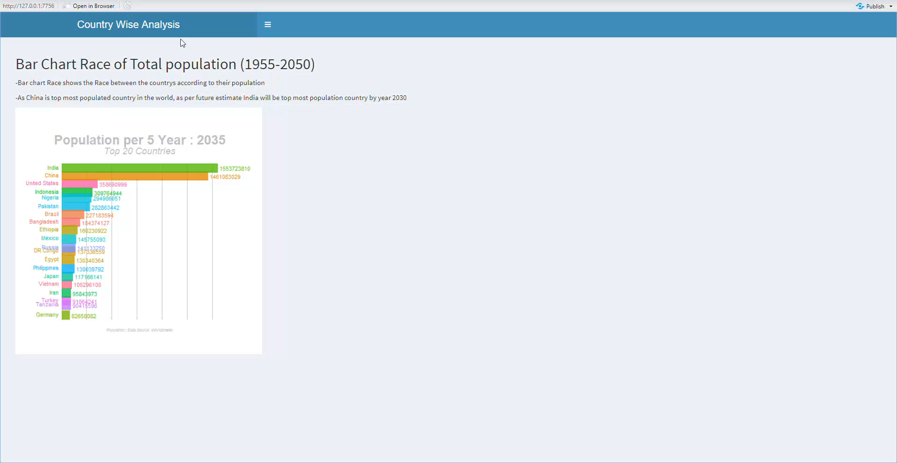

Slide 9


VISUALIZATIONS
We’ve tried to visualize our data in the following slides using various graphs like heatmaps, line graphs etc.

Slide 10
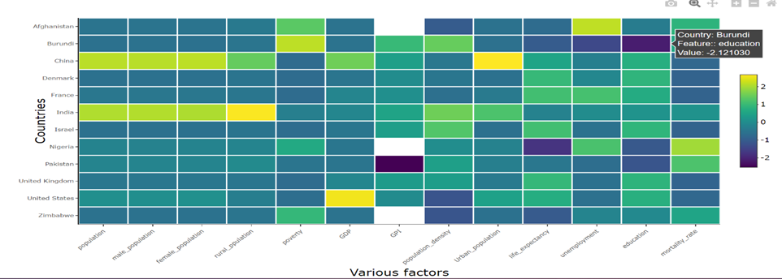

HEATMAP
This is basically a visual representation of our dataset. This particular heatmap is of the year 2018 for various countries like India, China, Pakistan, Israel etc. The different colours depict the individual values of factors on x axis for each country on the y axis. As the colorbar on the side shows, yellow represents high values whereas dark blue represents lowest values. For example, here we can see that, India and China’s population which are greenish in colour are highest among the selected countries. For unemployment, Afghanistan is at the top among all the other selected countries.

Slide 11
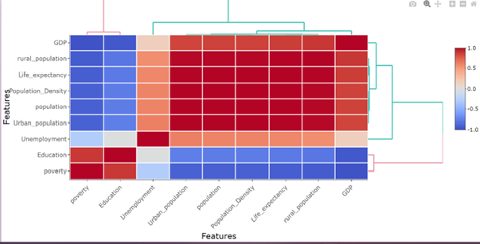
Correlation heatmap
This is a correlation heatmap for a particular country, here it is India. In this we have tried to analyse how each factor is correlated with each other and what is the strength of that relationship. For this we’ve only focused on the 2015 – 2020 time frame as for other years there were a lot of NA values.

Slide 12
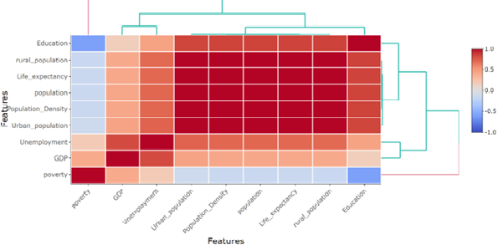
This is the correlation heatmap for the country Afghanistan.

Slide 13
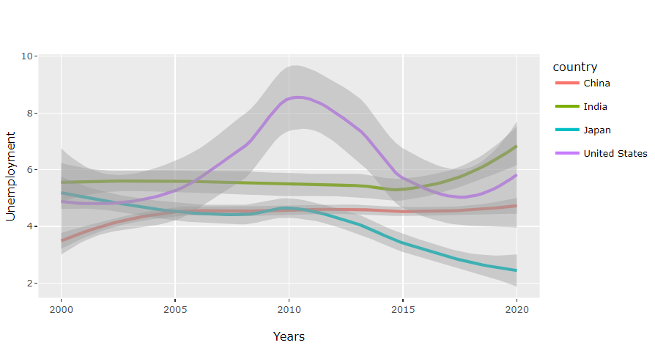
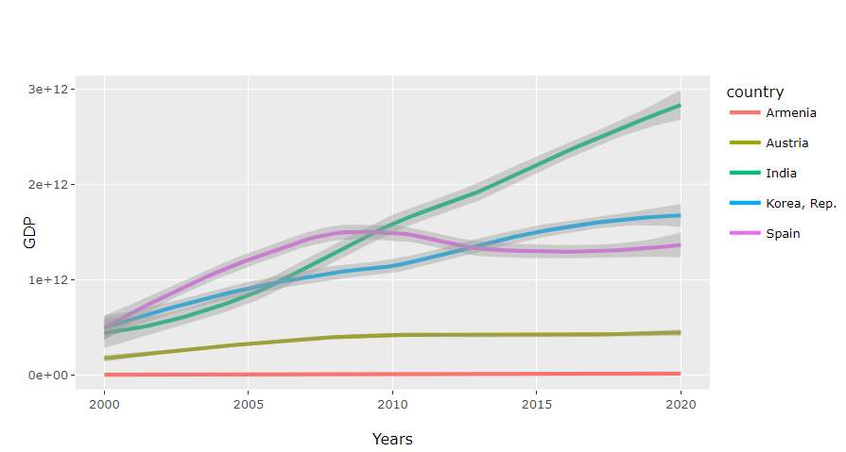
LINE GRAPHS

Slide 14
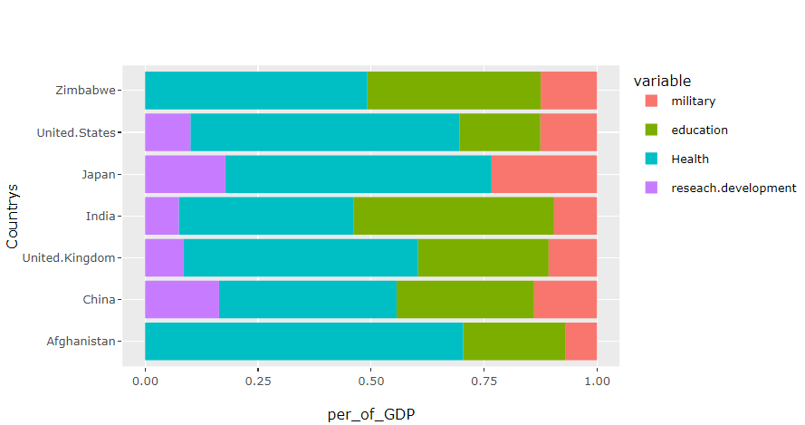
STACKED BAR GRAPH

Slide 15


INTERPRETATION
After analysing the graphs, we’ve came across these findings.

Slide 16
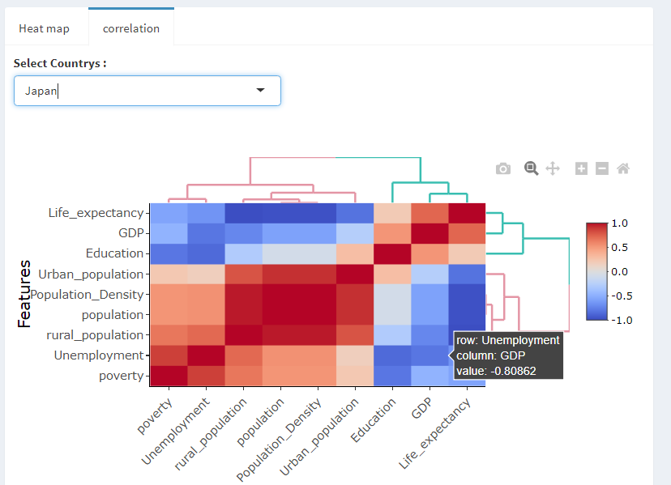
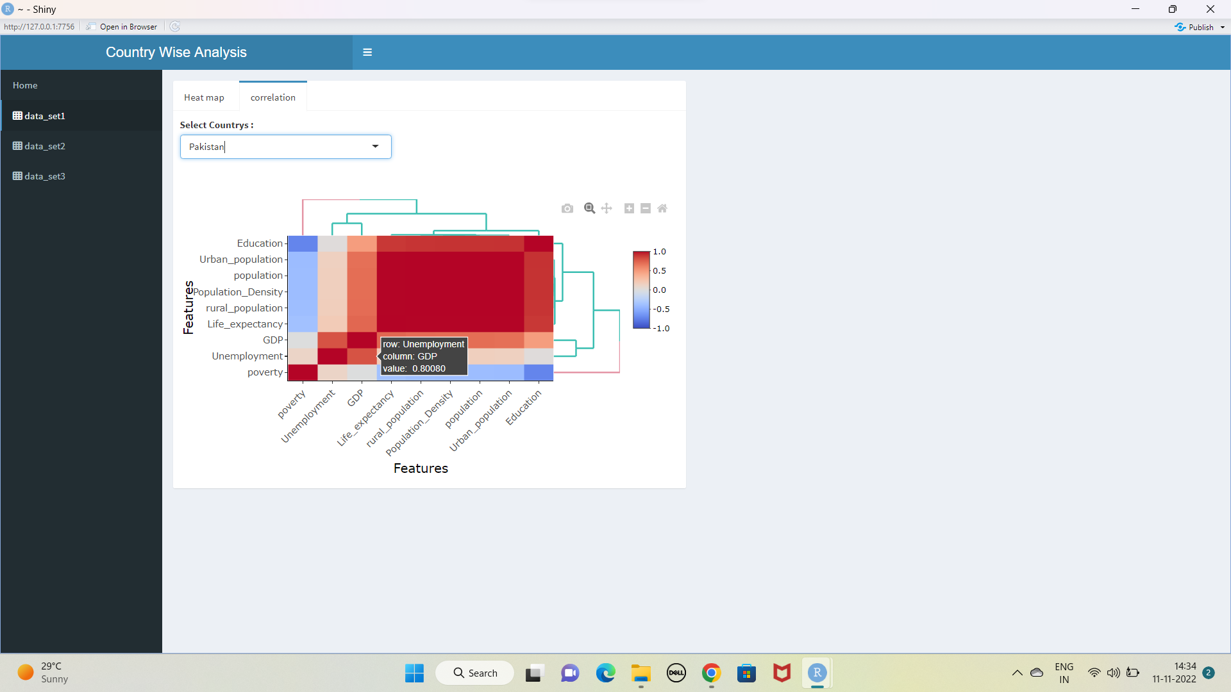
It is a general belief that if GDP of a country increases then the unemployment rate for example will decrease. However Japan and Pakistan show opposing qualities in this sense.
For Japan, GDP and unemployment rate are negatively correlated but they are positively correlated for Pakistan.

Slide 17
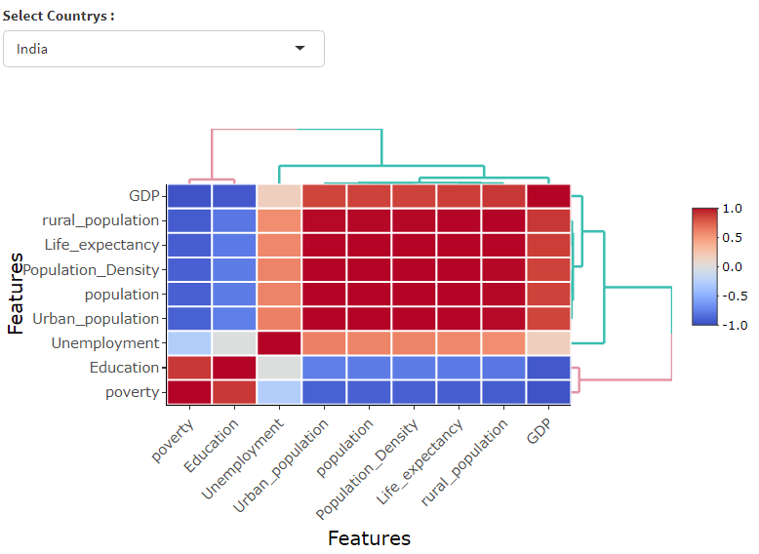
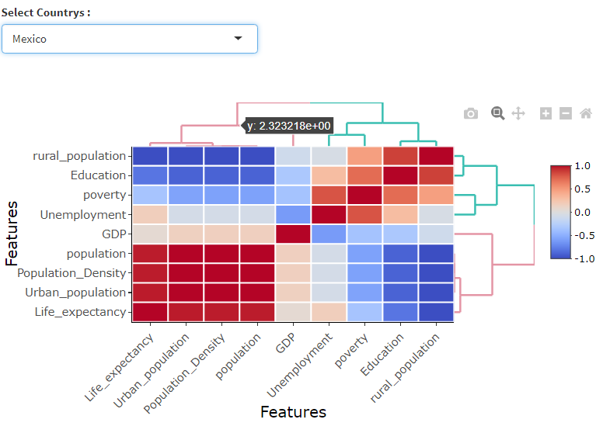
Another such belief is for unemployment and poverty rates, that they are directly related to each other. But for Mexico with a positive correlation between the two, and India with a negative relation, things are not as they seem to be.

Slide 18
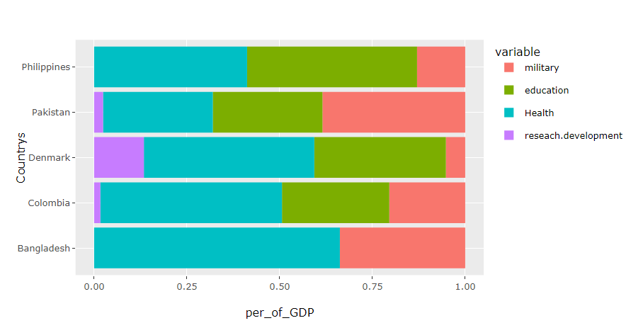
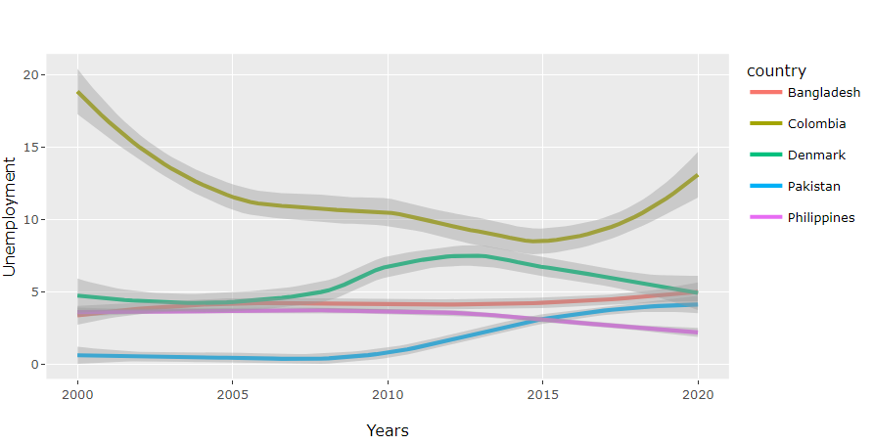
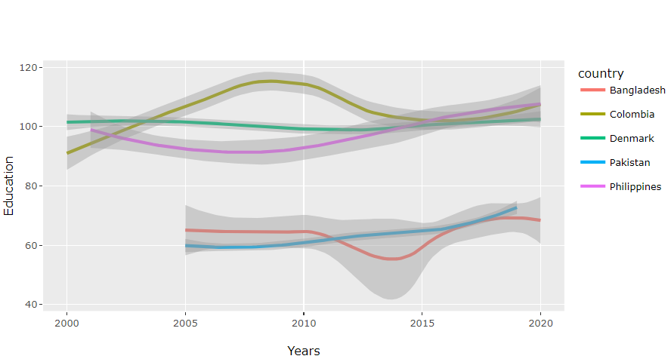
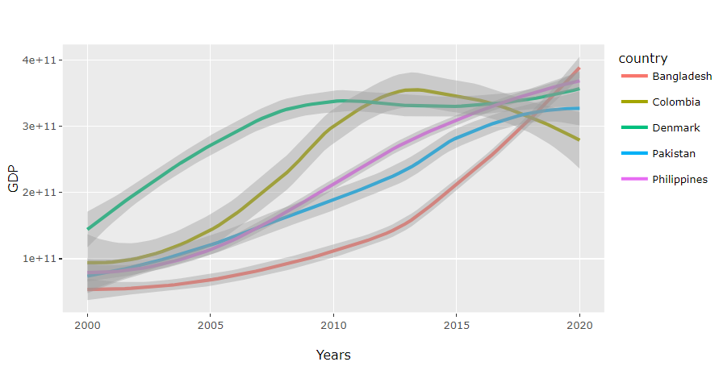
We can infer from these graphs that if a country is investing more in a sector then it is directly producing positive results in such sectors except for certain outliers which are getting affected by some external factors.

Slide 19
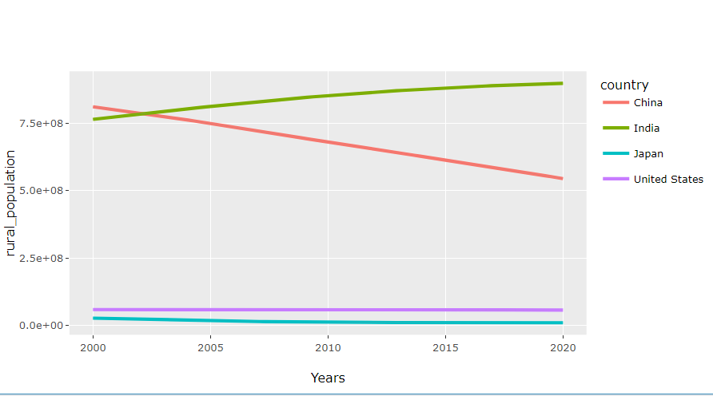
Another exception that we came across was that for almost all other countries, rural population keeps on increasing with each passing year, nut for China rural population is on a steady decline. So, increase in urban population is the only contributing factor to the increase in population in China, whereas for other countries, urban and rural population both are equally contributing towards population.

Slide 20


THANK
YOU

